Slide 1
OFFSET

Slide 2
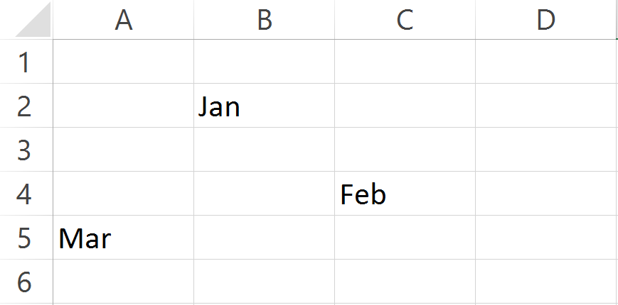
Journey from “Jan” to “Feb”
2 rows down and 1 column right

Slide 3
Journey from “Feb” to “Mar”

Slide 4
Journey from “Feb” to “Mar”
2 rows down and 1 column right

